Slide 1
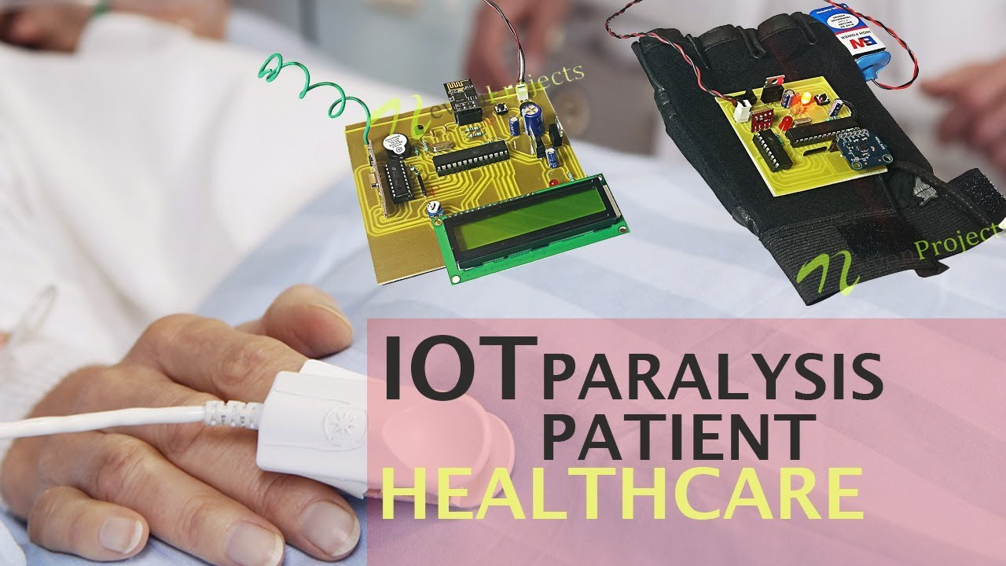
GSM-BASED PARALYSIS PATIENT HEALTH MONITORING SYSTEM
Submitted by –
Subhajit Ghosh (11500321011)
Suroj Mete (11500321106)
Uddipan Ghosh (11500321030)
Sandipan Saha (11500321018)

Slide 2
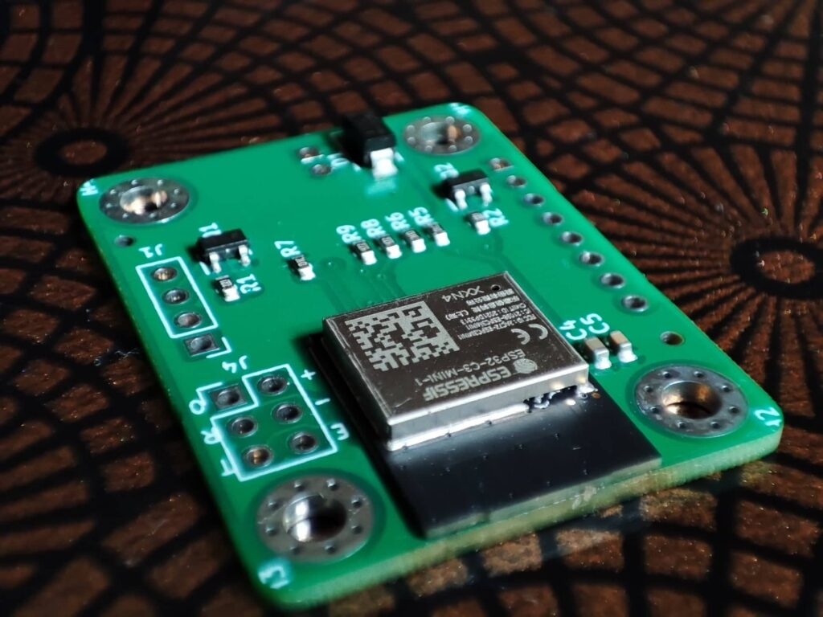
CONTENT
Abstract
Activity Chart
Introduction
Components
Circuit Diagram
Work Progress till date
Future plan
Conclusion
Reference

Slide 3
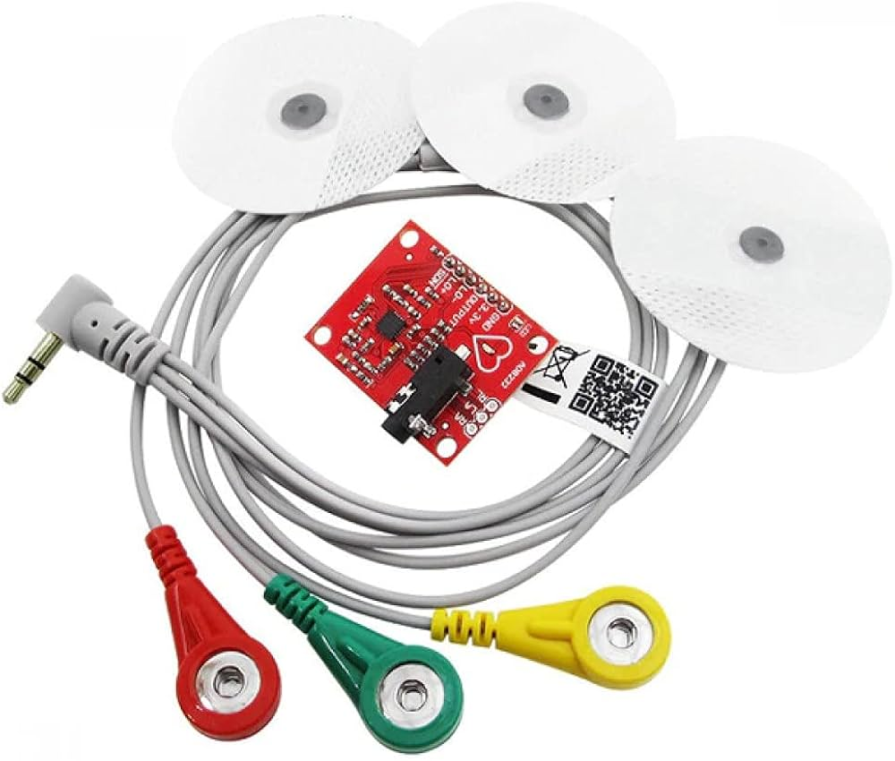
Abstract
The GSM-Based Paralysis Patient Health Monitoring System is designed to help monitor the health of patients with paralysis in real time. This system uses different sensors to track important health signs like temperature, heart rate, and movement. An Arduino microcontroller processes this information and displays it on a simple 16x2 LCD screen for easy viewing. For remote communication, the system uses a GSM module to send health updates and alerts to caregivers via SMS. In case of an emergency, it can also share the patient’s location. Additionally, a voice module allows patients with speech difficulties to send pre-recorded messages for help. Overall, this project aims to improve patient care and provide timely support, enhancing the quality of life for those with paralysis.

Slide 4
Timeline | Activity
September 2024 | Extensive study on IoT Arduino ATmega 2560, SIM 900 GSM GPRS, flux sensor, etc.
October 2024 |  | Establishing the work flow (flow chart) & Making of the design of the project
November 2024 |  |  | Model making (Hardware part)
December 2024 |  |  |  | Prepare project report
PLANNING
Odd Semester

Slide 5
TimeLine | Activity
January 2025 | Developing the Software part (writing code, uploading code, etc.)
February 2025 |  | Fixing the run time issues of the Project
March 2025 |  |  | Finalize the Project
20-31 March |  |  |  | Add some Additional functionalities
April 2025 |  |  |  |  | Launch of the final project
May 2025 |  |  |  |  |  | Prepare final
PLANNING
Even Semester

Slide 6
In this presentation, we explore the innovative integration GSM based paralysis patient’s health monitoring system. Our project aims to provide a solution by using modern technology to track vital health signs like heart rate, temperature, and movement in real time. By integrating sensors with a microcontroller, we can display this information locally and send alerts to caregivers through SMS using a GSM module. This system not only ensures timely medical assistance but also enhances the overall quality of life for patients by allowing them to stay at home. Through this presentation, we will explore the features, components, and benefits of our health monitoring system.
INTRODUCTION

Slide 7
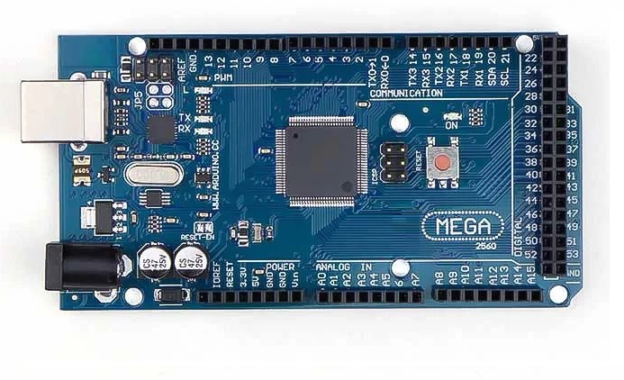
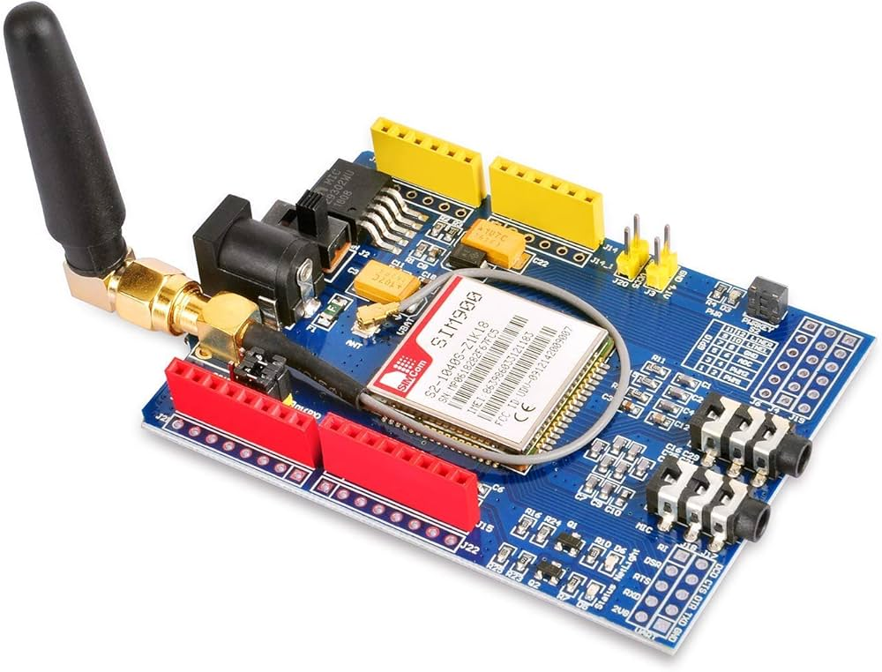
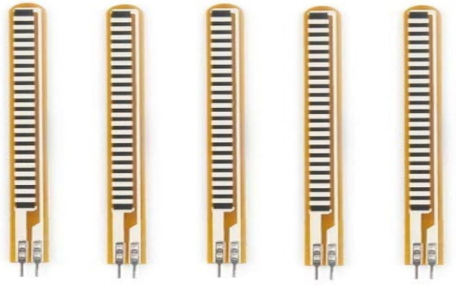
Arduino mega 2560 microcontroller
COMPONENTS
GSM-GPRS SIM900 module
Flex Senor

Slide 8
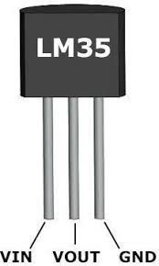
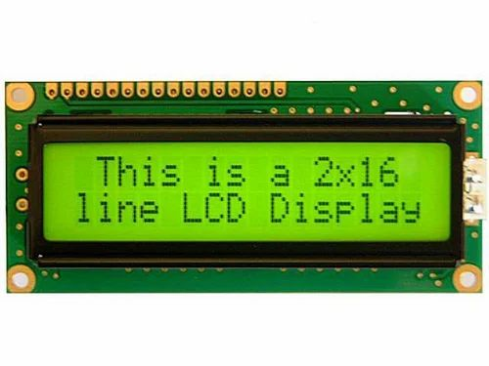
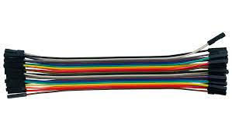
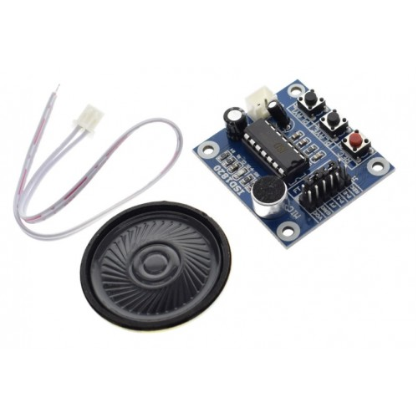
LM35 Temperature sensor
16 x 2 ICD Display
Jumpers Wires
ECG Sensor
APR33A3 voice module

Slide 9
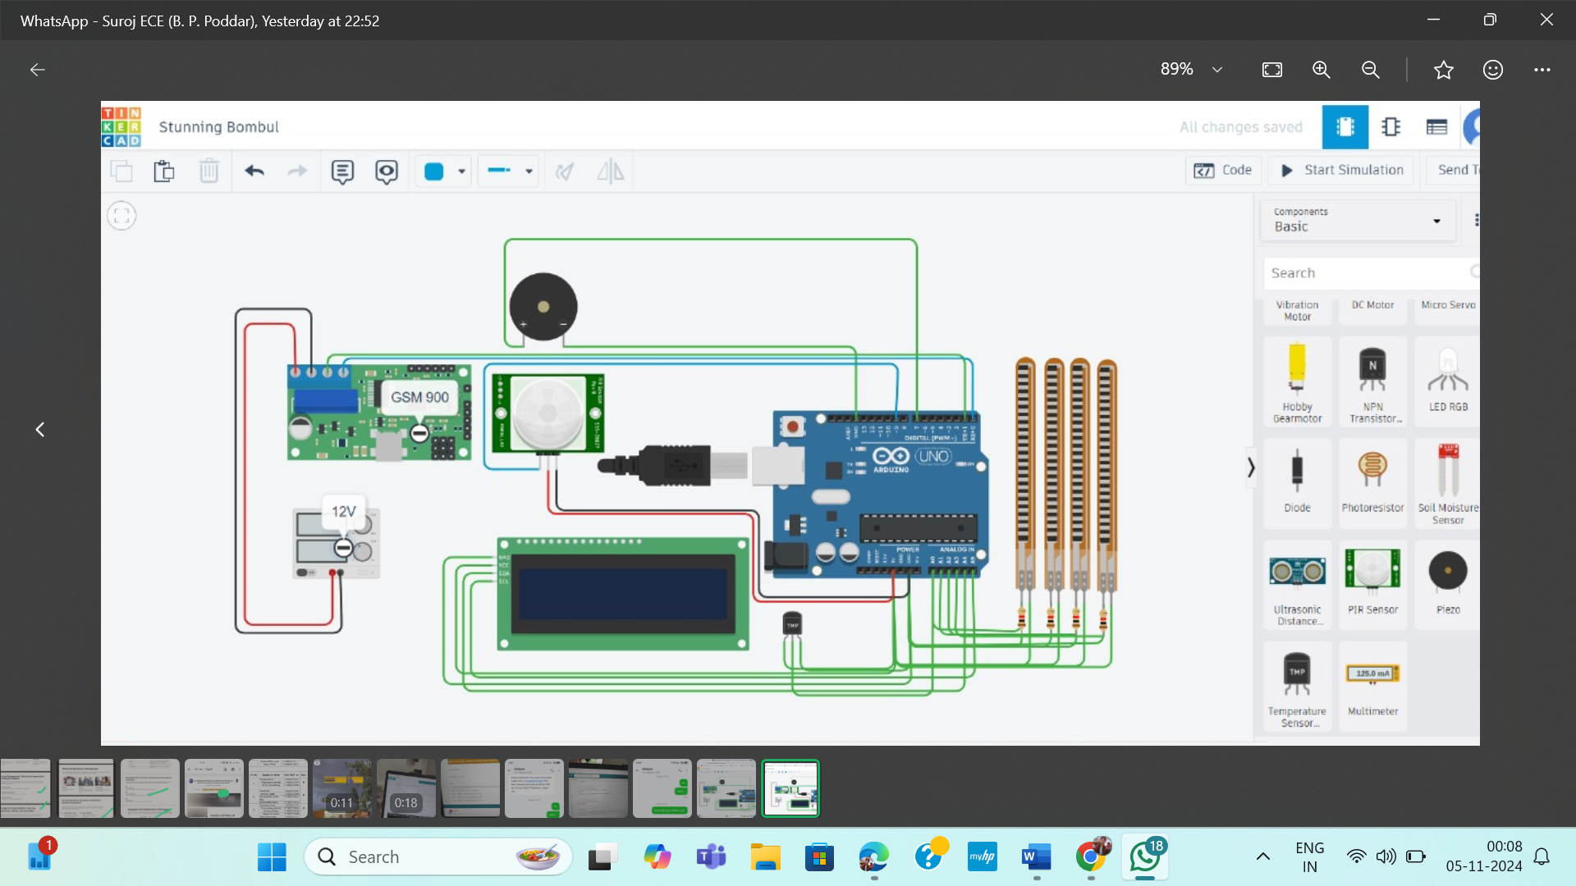
CIRCUIT DIAGRAM

Slide 10
WORKING PRINCIPLE
The GSM-Based Paralysis Patient Health Monitoring System works by using various sensors to continuously monitor the patient's vital signs. Here’s how it functions:
Data Collection: Sensors measure important health parameters like body temperature, heart rate, and limb movement.
2. Processing: An Arduino microcontroller collects data from these sensors, processes the information, and makes it ready for display and communication.
3. Local Display: The collected data is shown on a 16x2 LCD screen, allowing caregivers to check the patient’s health at a glance.
4. Remote Communication: The GSM module sends health updates and alerts via SMS to caregivers or family members, ensuring they are informed of any changes.
5. Emergency Alerts: If the system detects critical health changes, it sends an immediate alert for quick assistance.
6. Voice Communication: A voice module allows patients with speech disabilities to send pre-recorded messages for help.
The working principle of a smart door lock system using Arduino involves several key steps:
Input Recognition: The system uses a keypad module or another input method to receive a user's input, usually a code or password.
Arduino Processing: The Arduino, acting as the brain of the system, processes the input received from the keypad module.
Code Validation: The Arduino checks if the entered code matches a pre-defined code stored in its memory. If the entered code matches the stored code, the Arduino proceeds to the next step. Otherwise, it denies access.
Lock Control: Upon successful code validation, the Arduino sends a signal to control the locking mechanism. This signal could be sent directly to an electronic lock or through a relay to control a traditional mechanical lock.
Locking/Unlocking Action: Based on the signal received from the Arduino, the locking mechanism either locks or unlocks the door.

Slide 11
Completed research, planning, and studied GSM-based health monitoring with speech functionality using Arduino.
Set up Arduino IDE and finalized the circuit diagram.
Implemented hardware and coding for GSM module, ECG sensor, temperature sensor, and two flex sensors.
Successfully integrated all components with Arduino Mega 2560.
Display coding completed for sensor results.
Conducted calibration; flex sensors now provide accurate readings.
Work Progress till date

Slide 12
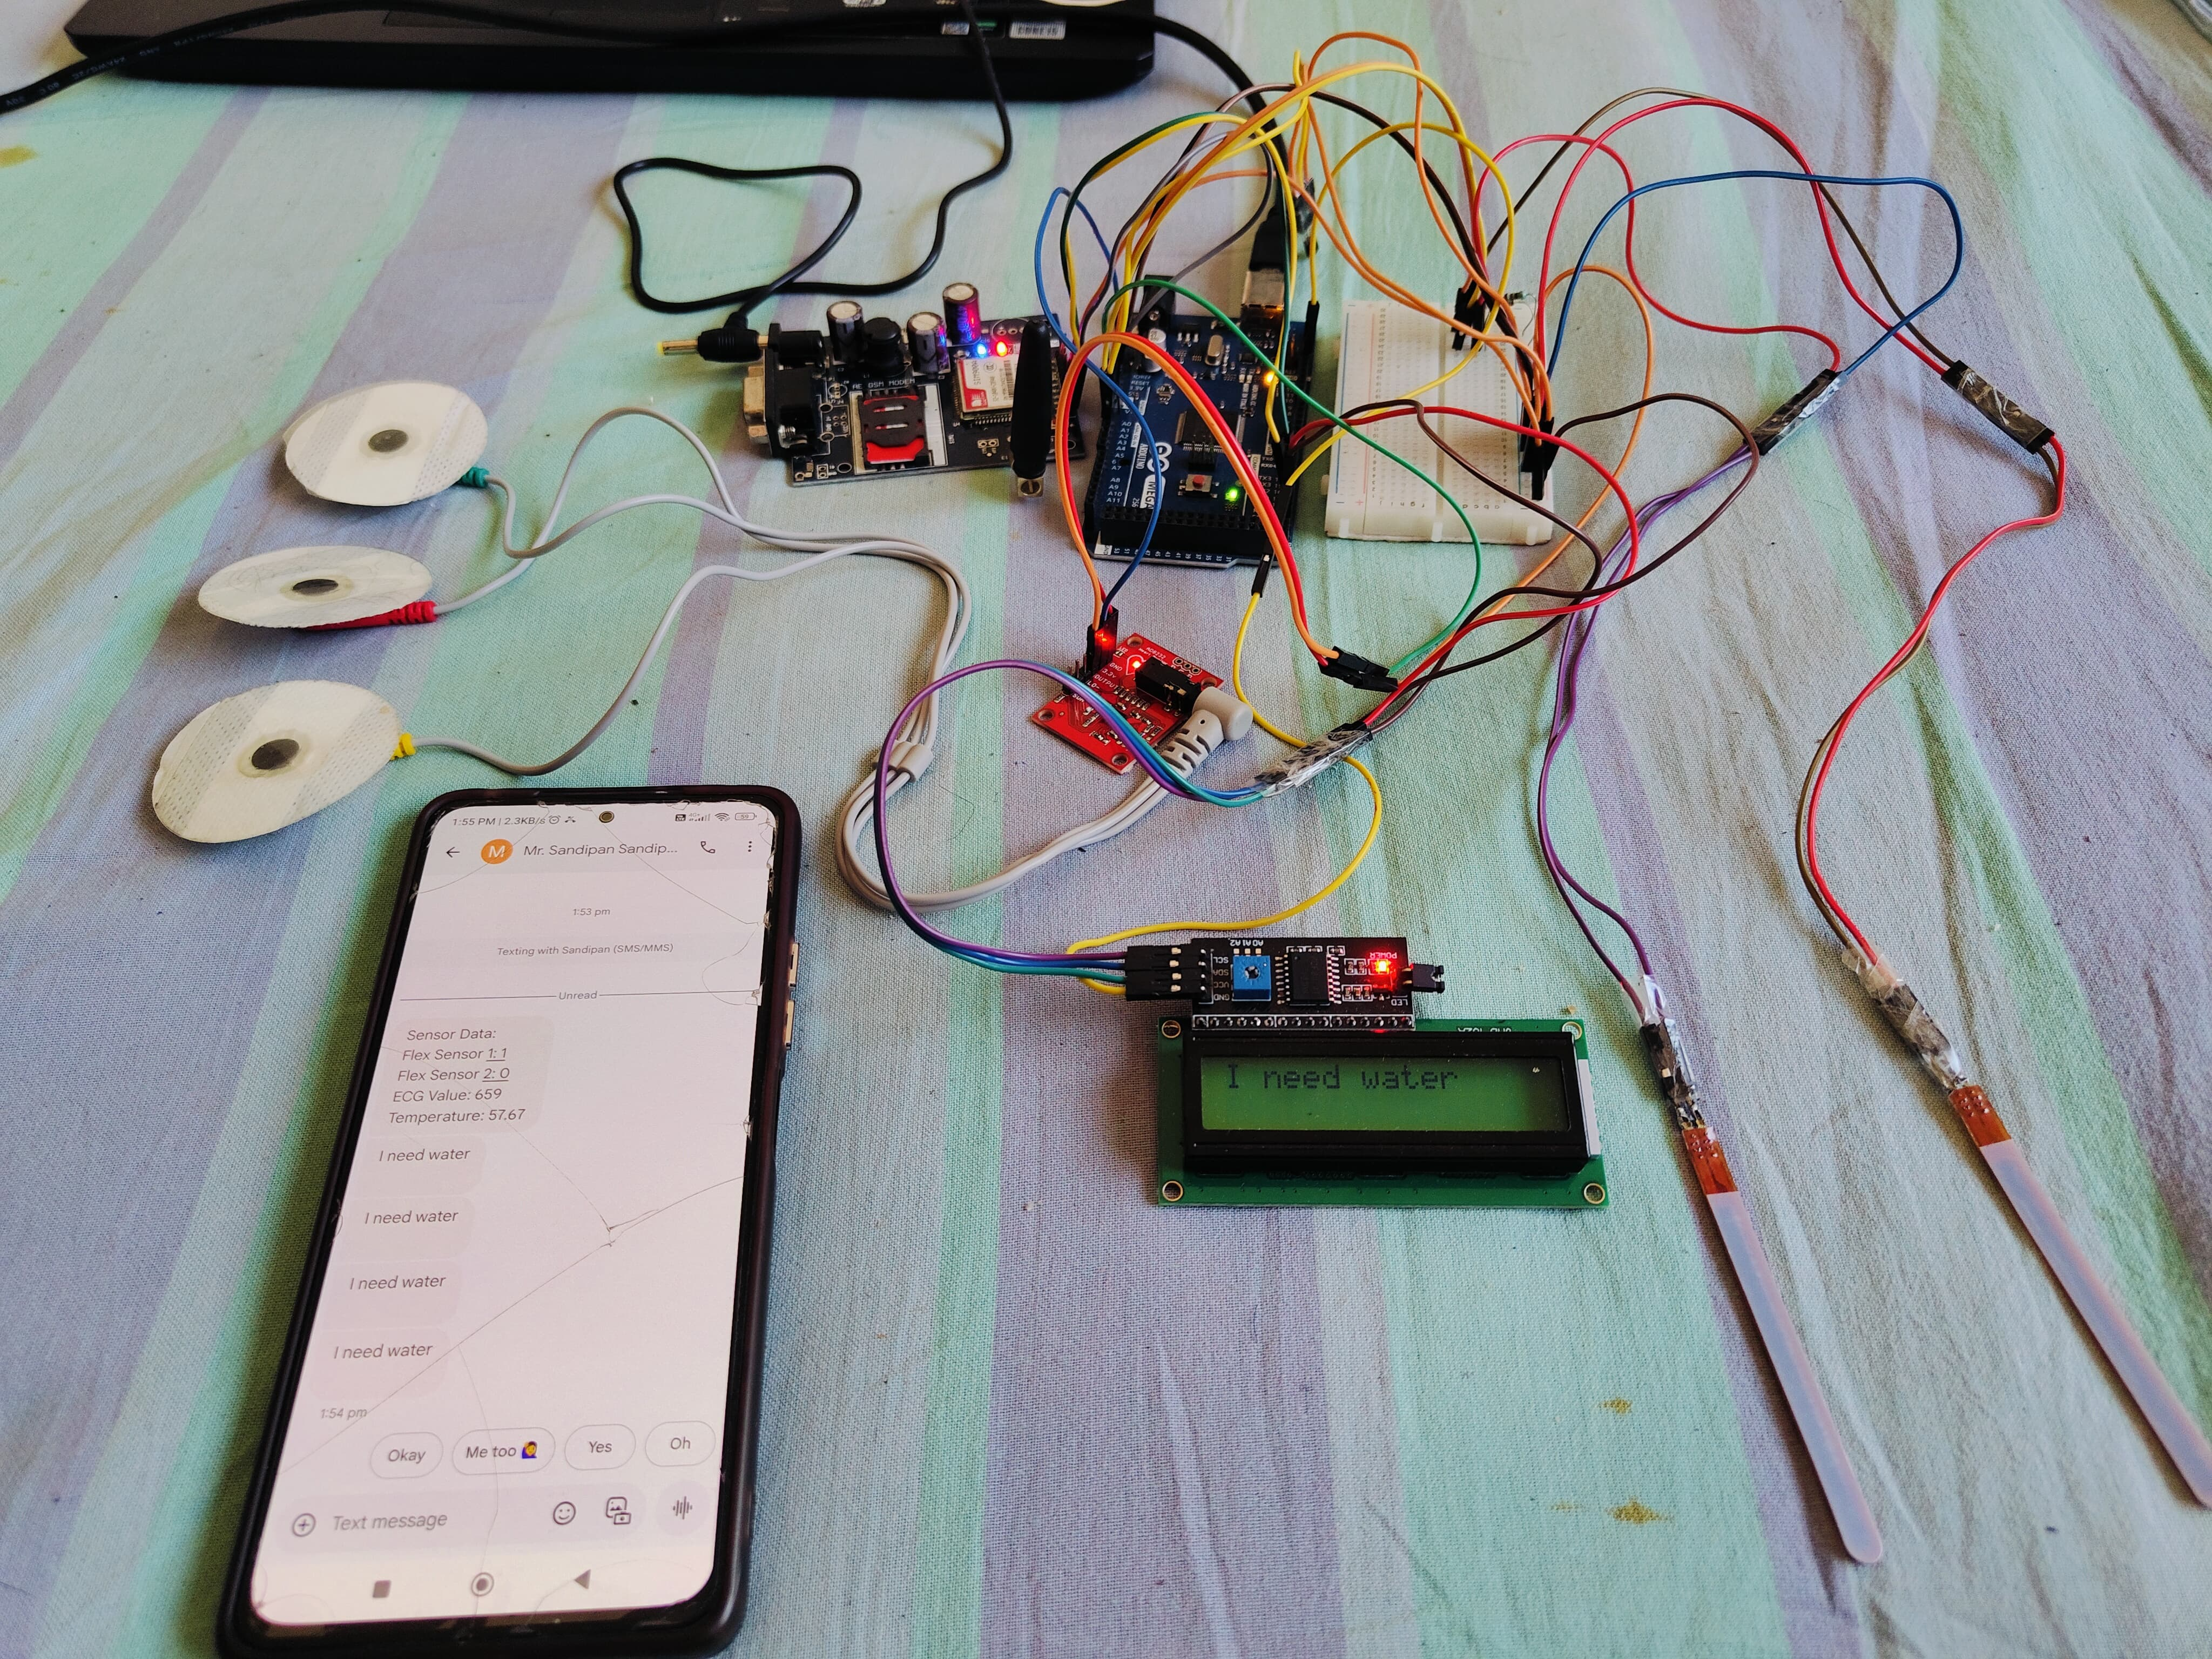
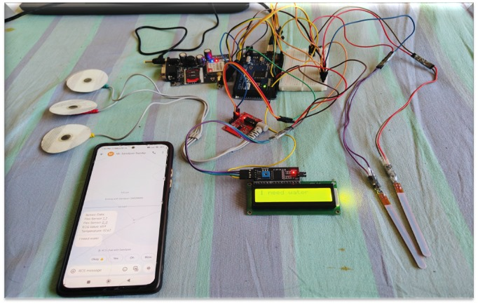
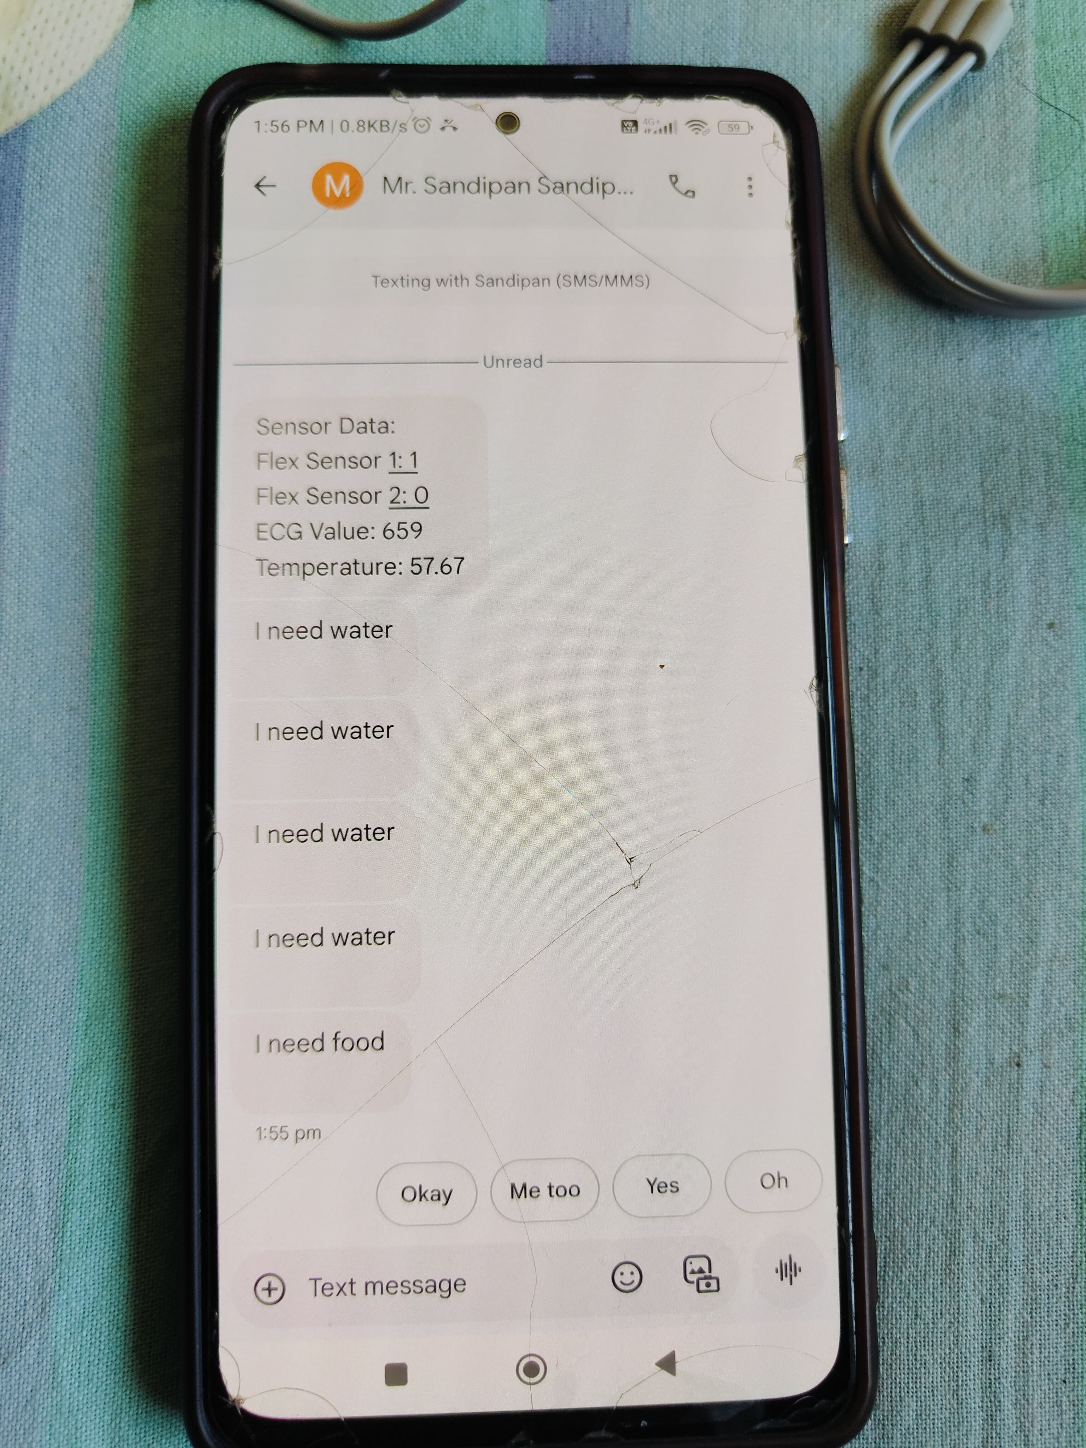
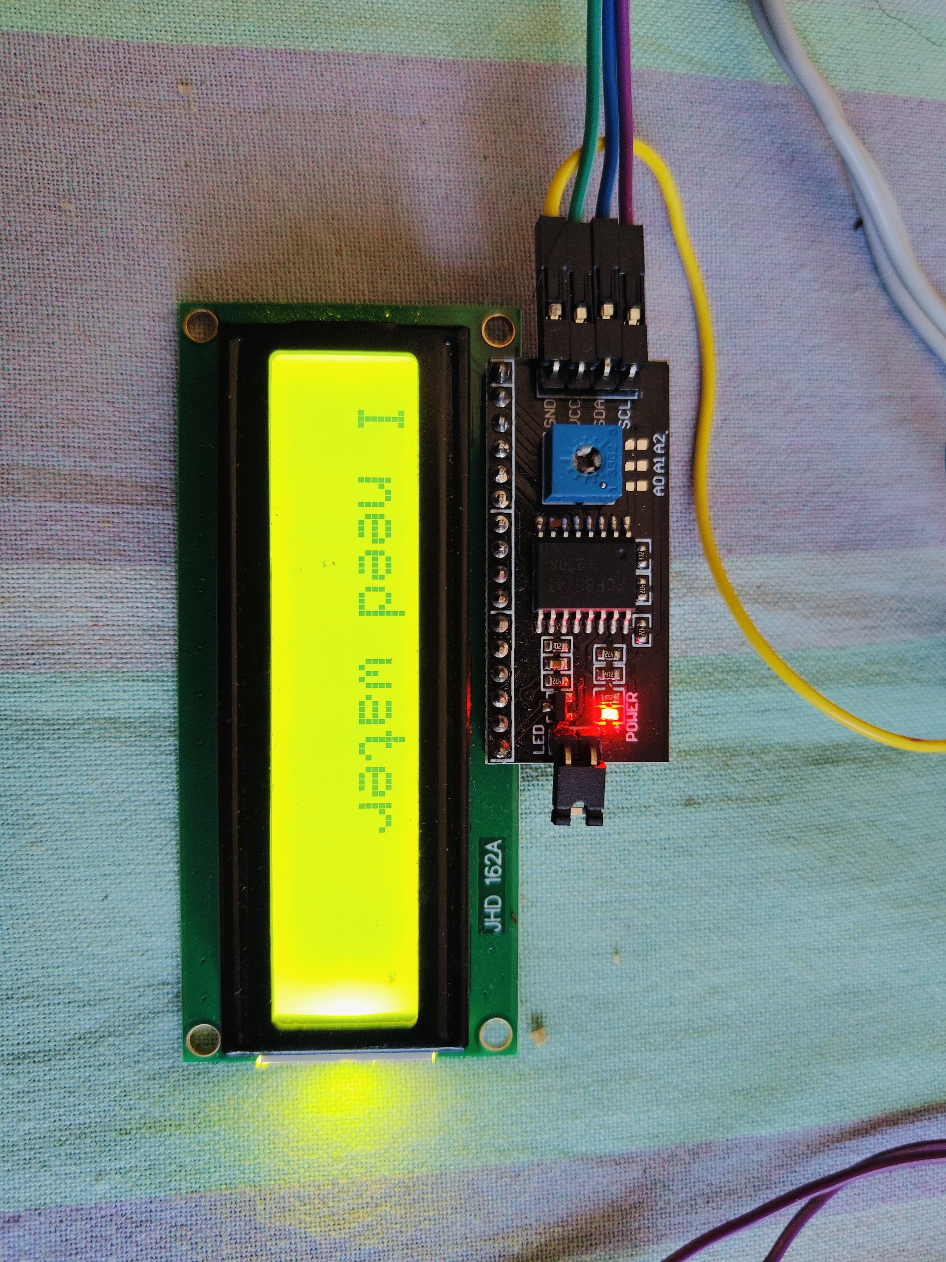
Image of the Project

Slide 13
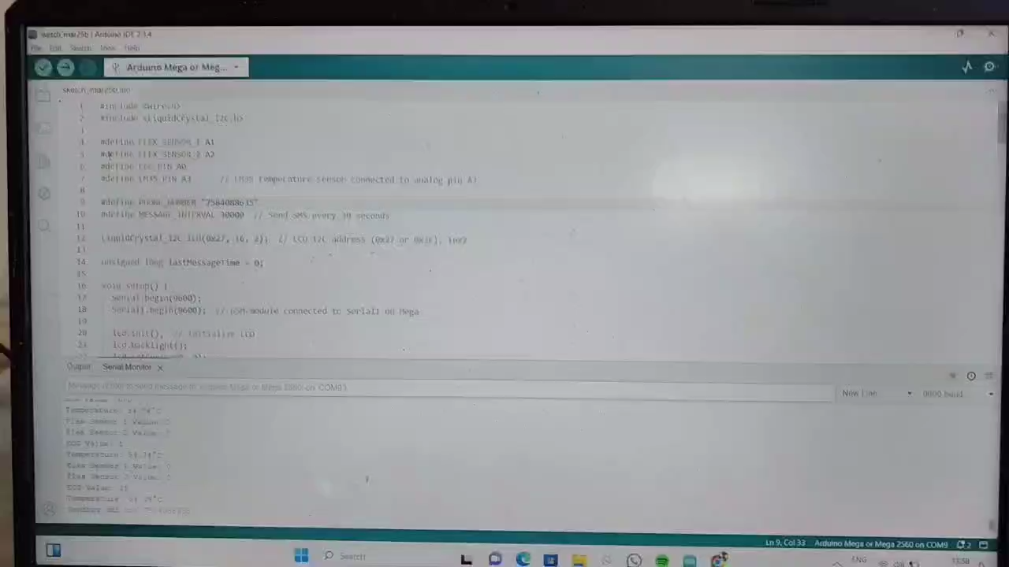
Project Video

Slide 14
Our future plans for the GSM-Based Paralysis Patient Health Monitoring System include:
More Sensors: Adding sensors to measure blood pressure and oxygen levels for a complete health check.
2. Mobile App: Developing an app to help caregivers view and analyze health data easily.
3. Smart Alerts: Using advanced technology to predict health emergencies before they happen.
4. User-Friendly Interface: Improving the LCD display and controls to make it easier for patients and caregivers to use.
5. Cloud Storage: Storing health data in the cloud for easy access by healthcare providers.
6. Wider Use: Adapting the system for other patients with chronic health conditions.
Future Plan

Slide 15
CONCLUSION
In conclusion, the GSM-Based Paralysis Patient Health Monitoring System is an innovative solution that enhances care for patients with paralysis. By using sensors and communication technology, it provides real-time monitoring of vital signs and immediate emergency alerts, improving the quality of care and allowing patients to maintain some independence.
Our future plans to expand the system with more features and a user-friendly interface will further increase its effectiveness. Overall, this project aims to empower patients and caregivers, leading to better health outcomes and a higher quality of life. Thank you for your attention!

Slide 16
R. Kumar and M. P. Rajasekaran, "An IoT based patient monitoring system using Raspberry Pi," 2016 International Conference on Computing Technologies and Intelligent Data Engineering (ICCTIDE'16), Kovilpatti, India, 2016, pp. 1-4.
K. A. Venkatesh, R. Kumar, and S. S. Jha, "Health Monitoring System using IoT," International Journal of Computer Science and Information Technologies, vol. 7, no. 3, pp. 1137-1141, 2016.
S. Pantelopoulos and N. G. Bourbakis, "A Survey on Wearable Sensor-Based Systems for Health Monitoring and Prognosis," 2010 32nd Annual International Conference of the IEEE Engineering in Medicine and Biology Society, Buenos Aires, Argentina, 2010, pp. 6023-6026.
REFERENCE

Slide 17


